Slide 1
Delhi College of Arts and Commerce
Guidelines to Using the RFID Technology in the Library

Slide 2
WHAT IS RFID ?
Radio Frequency Identification technology uses radio waves to identify people or objects. College library incorporated RFID technology for efficient library management and this includes RFID-enabled smart cards, a self-circulation kiosk for quick and easy book borrowing ,a book drop station for returns , and timely email notifications for over dues books. you can check each book transaction simultaneously.

Slide 3
How to Borrowing Books Using the RFID Kiosk in the Library

Slide 4
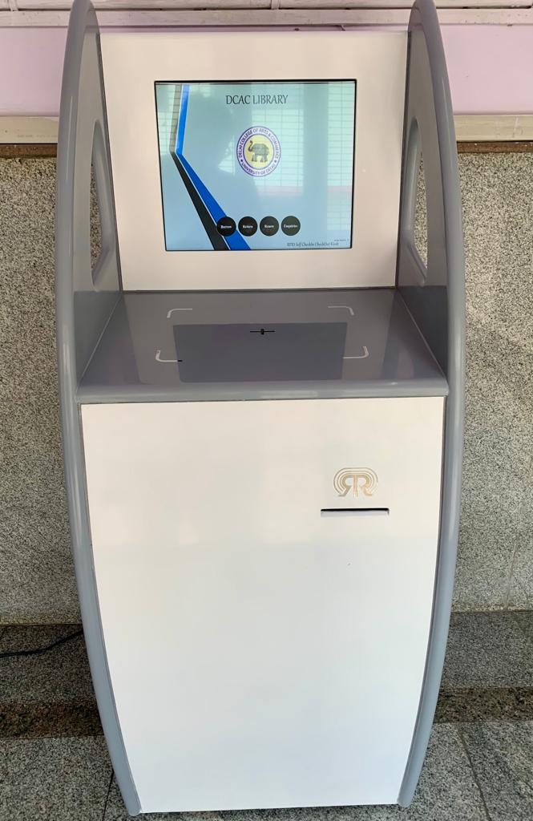
STEPS TO USE RFID TECHNOLOGY
Step 1: Approach the Self Check-In Check-Out Kiosk.
This kiosk is touchscreen-enabled and user-friendly, designed primarily for the issue and return of books.

Slide 5
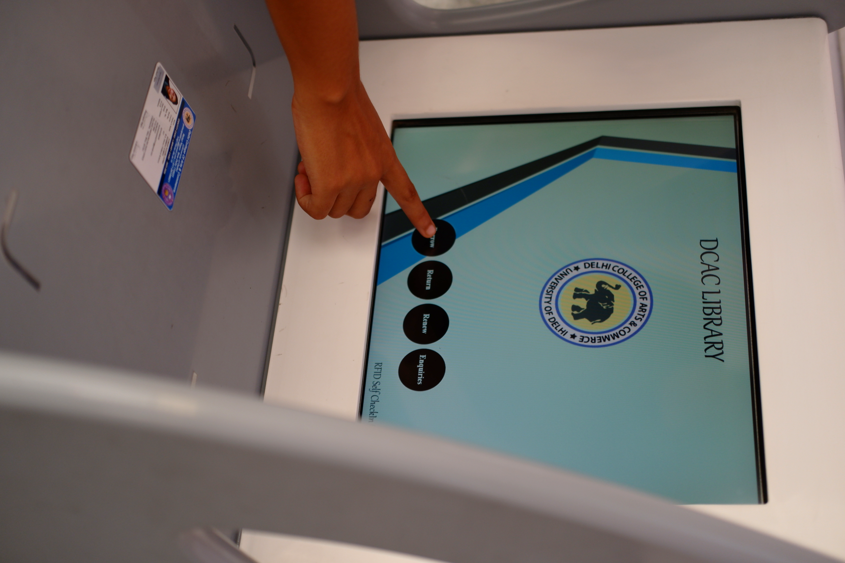
Step 2: Scan Your ID Card.
Place your ID card on the designated area of the RFID kiosk.
The kiosk will read and display your details on the screen.
Step 3: Initiate the Borrowing Process.
On the touchscreen, select the “Borrow” option.

Slide 6
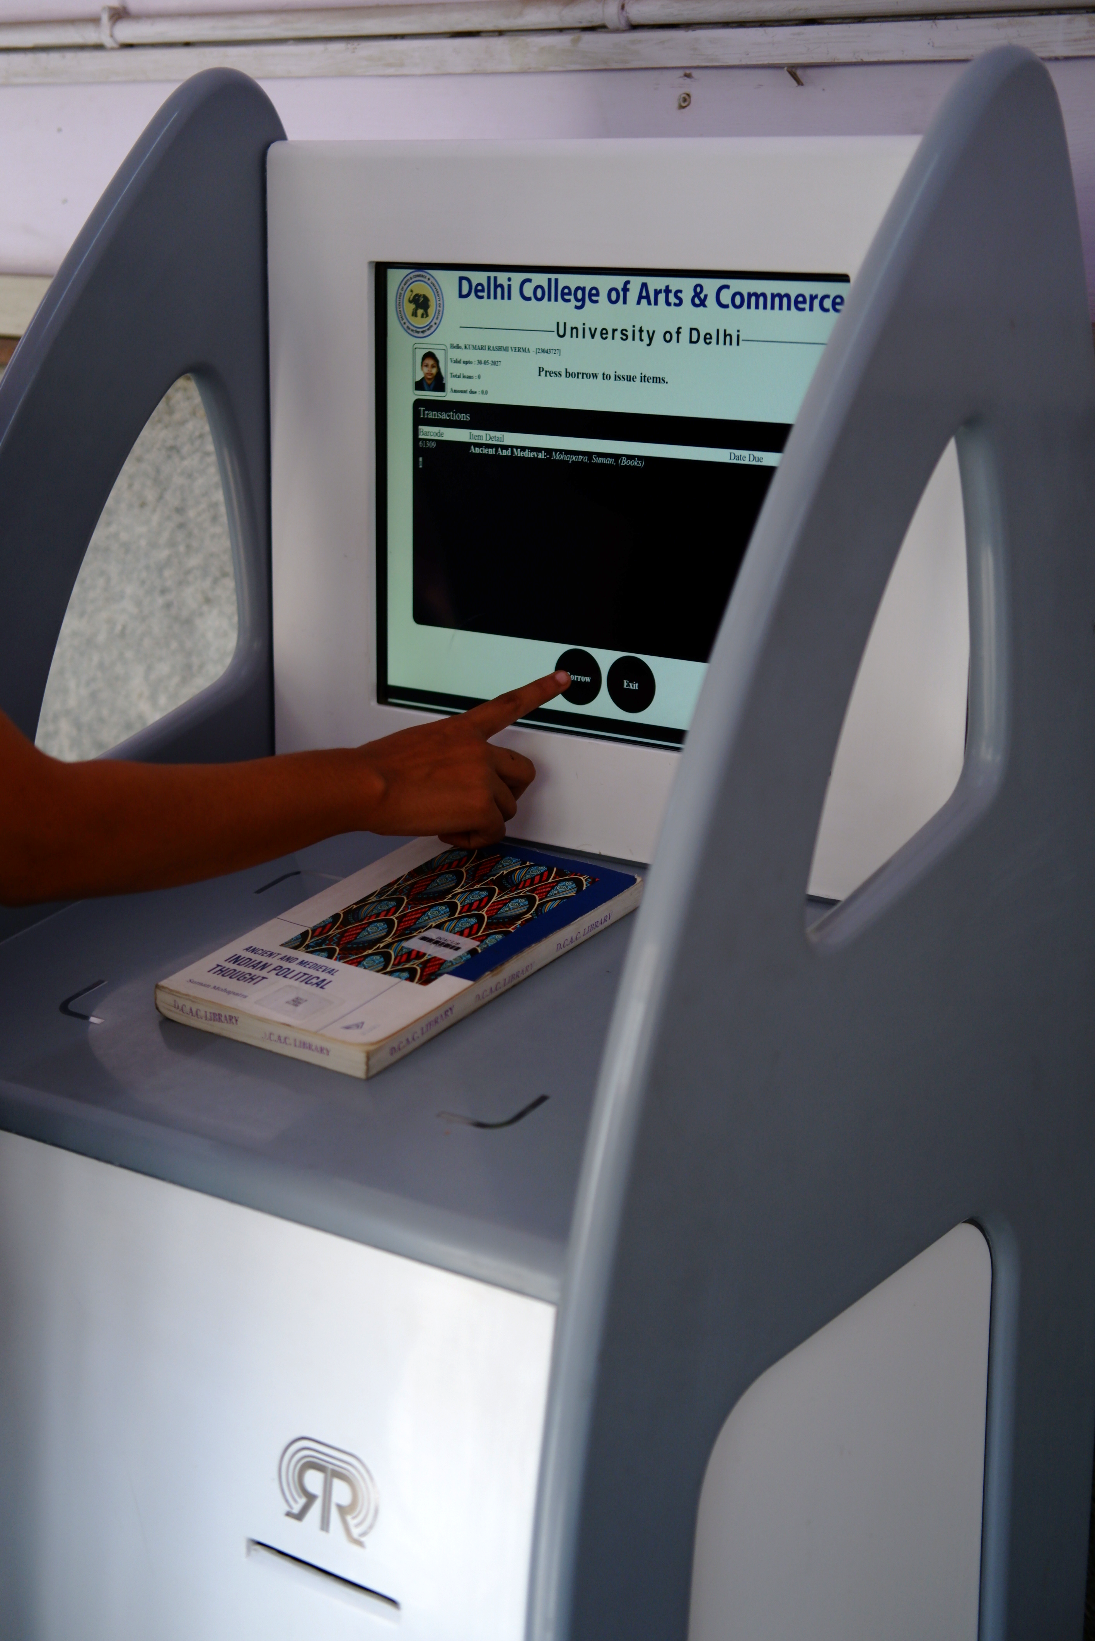
Step 4: Scan the Book(s).
The screen will display a message prompting you to “Place book(s) to borrow.”
Position the book(s) you wish to borrow on the designated area of the kiosk.
The kiosk will scan and display the book details, including Barcode, Item Details, and Date Due.

Slide 7
Step 5: Confirm Borrowing.
Click on the “Borrow” option again on the touchscreen.
The system will process the request, and the book(s) will be issued in your name.

Slide 8
Step 6: Check the Confirmation Message.
The screen will show a "checked-out successfully" message for the borrowed book(s).

Slide 9
Step 7: Exit the Borrowing Process.
Click on the “Exit” option on the touchscreen to conclude the borrowing procedure.

Slide 10
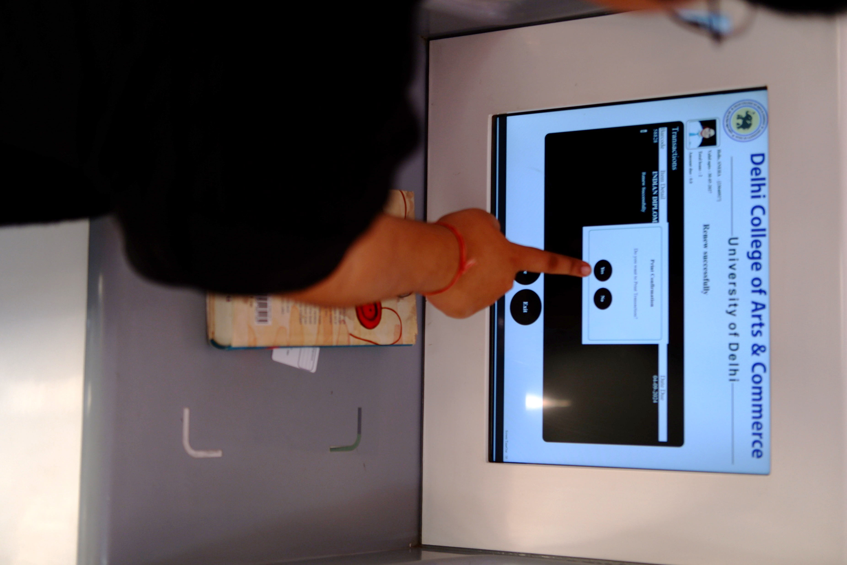
Step 8: Print Transaction Receipt
The screen will ask if you'd like a print confirmation.
Select the “YES” option.
The kiosk will print an automated checked-out transaction receipt for you.

Slide 11
Step 9: Receive Confirmation Email.
A confirmation email detailing the borrowed book(s) will be sent to your registered email address as per the library’s records
Step 10: Handover the Receipt to Library Staff.
Before leaving, hand over the printed receipt to the library staff stationed at the exit gate.
Note
Remember to return the borrowed book(s) before the due date to avoid an Any late fine.

Slide 12
How to Returning Books using the RFID Kiosk in the library

Slide 13
Step 1: Approach the Self Check-In Check-Out Kiosk.
This kiosk is touchscreen-enabled and user-friendly, designed primarily for the issue and return of books.

Slide 14
Step 2: Initiate the Return Process.
Please hold your college ID card on the kiosk machine, then select the "Return" option on the touchscreen.

Slide 15
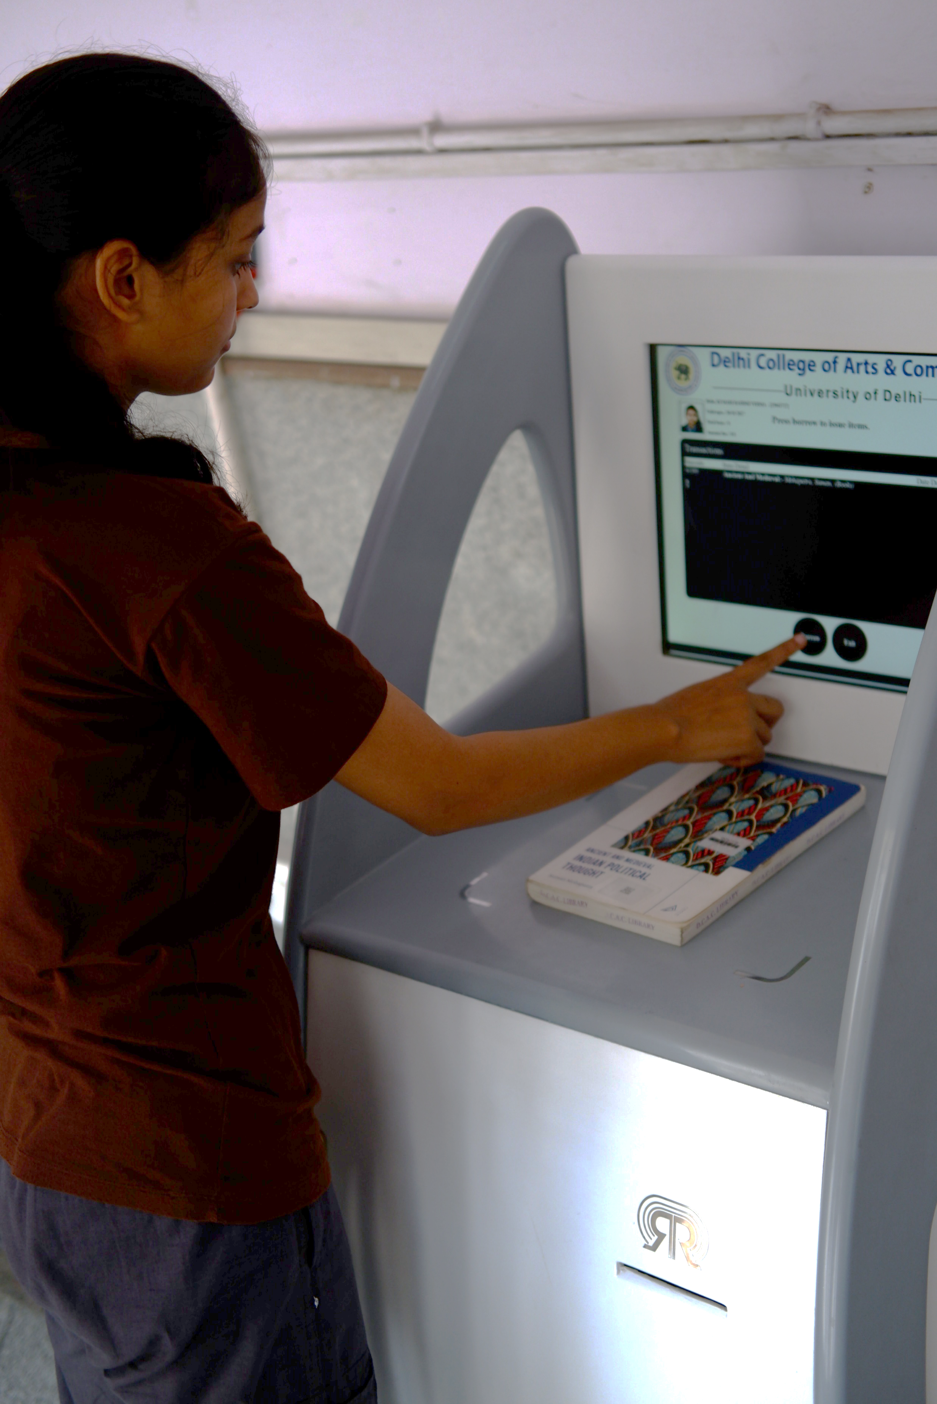
Step 3: Place the Book(s) on the Kiosk.
Position the book(s) you wish to return on the designated area of the kiosk.
The kiosk will scan and display the book details, including Barcode, Item Details, Date Due, and any applicable Fine
Step 4: Review Fine Details (if applicable).
If there's an overdue fine for the book(s), it will be displayed under the Fine column.
If no fine is applicable, the amount against the book(s) entry will show as Zero.

Slide 16
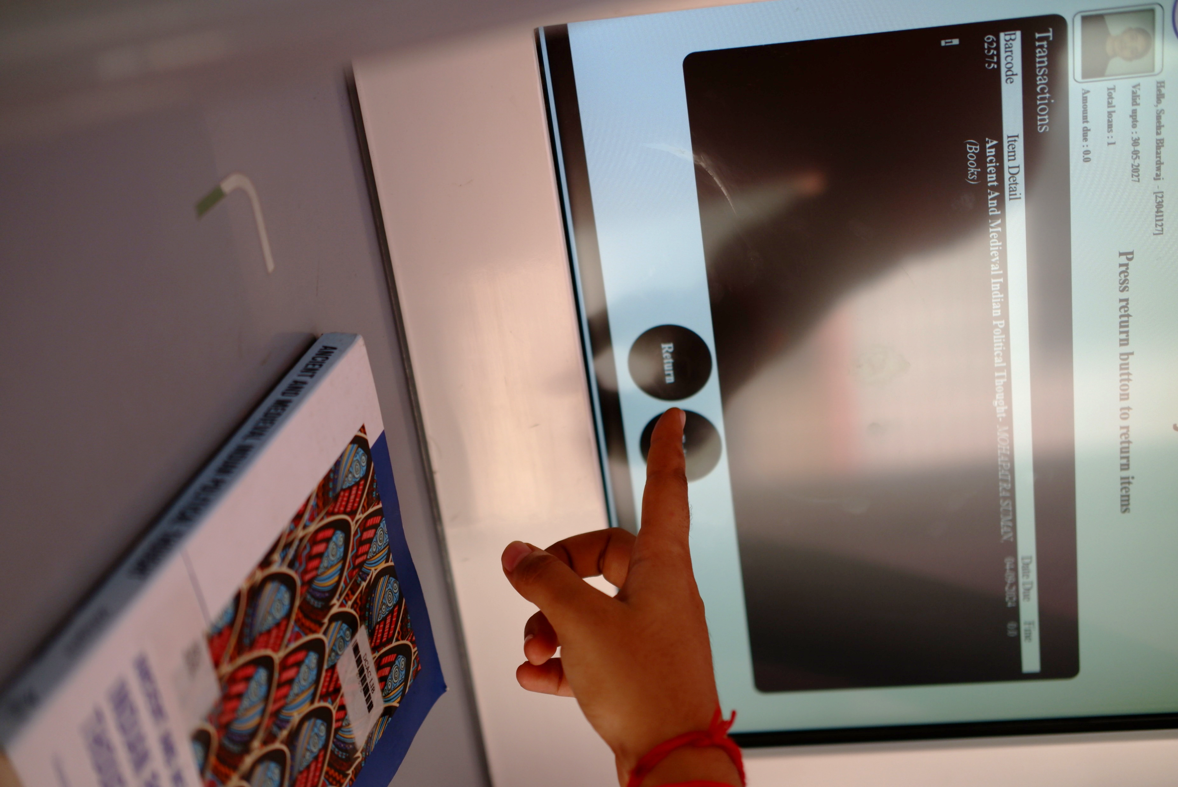
Step 5: Confirm Return.
Click on the “Return” option again on the touchscreen.
The system will process the request, and the book(s) will be successfully returned.

Slide 17
Step 6: Check the Confirmation Message. The screen will show a "checked-In successfully" message for the returned book(s).

Slide 18
Step 7: Exit the Return Process. Click on the “Exit” option on the touchscreen to conclude the return procedure.

Slide 19
Step 8: Print Transaction Receipt
The screen will ask if you'd like a print confirmation.
Select the “YES” option.
The kiosk will print an automated checked-out transaction receipt for you.
Step 9: Receive Confirmation Email.
A confirmation email detailing the returned book(s) will be sent to your registered email address as per the library's records.

Slide 20
Step 10: Address Overdue Fines (if applicable).
If there's an overdue fine for the book(s), visit the Circulation Counter to pay the amount.
If no fine is applicable, the return process is complete once you receive the automated checked-In transaction receipt.
Step 11: Handover the Receipt to Library Staff.
Before leaving, hand over the printed receipt to the library staff stationed at the exit gate.
Note - Always ensure to return books on time to avoid late fine.

Slide 21
How to Return Books using the RFID Book Drop kiosk in the library

Slide 22
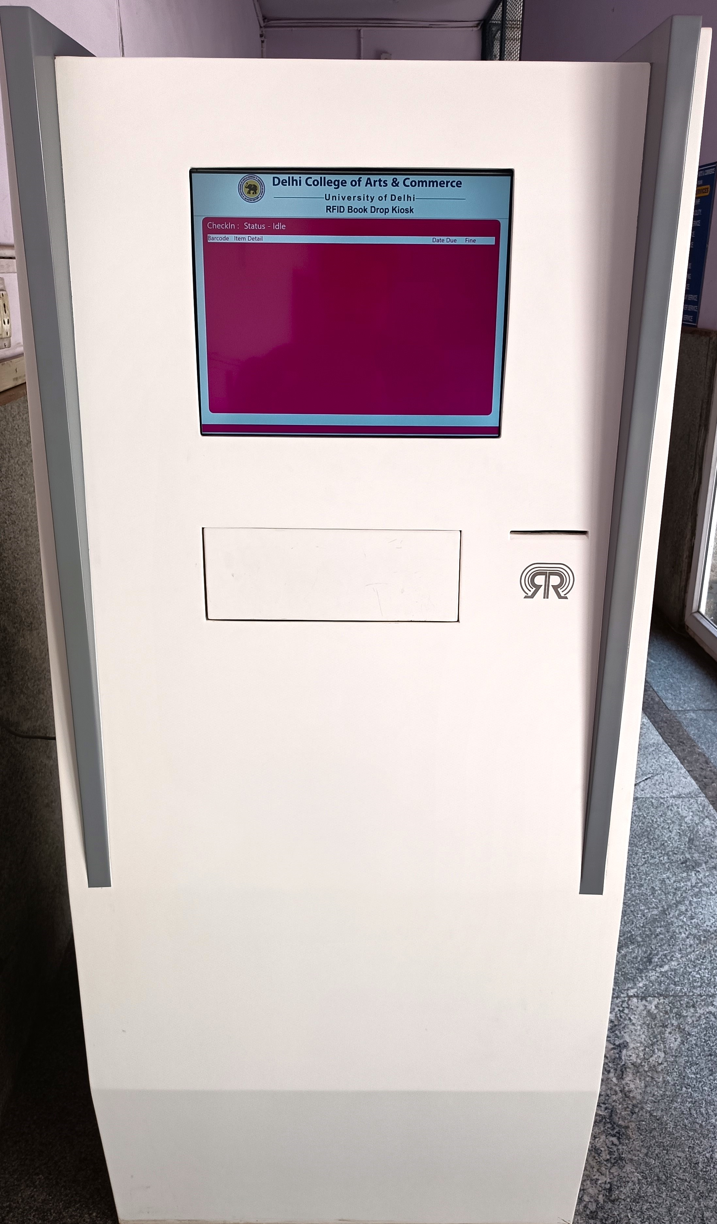
Step 1: Approach the RFID Book Drop kiosk.
This Book Drop kiosk is touchscreen-enabled and user-friendly, designed primarily for return of books.

Slide 23
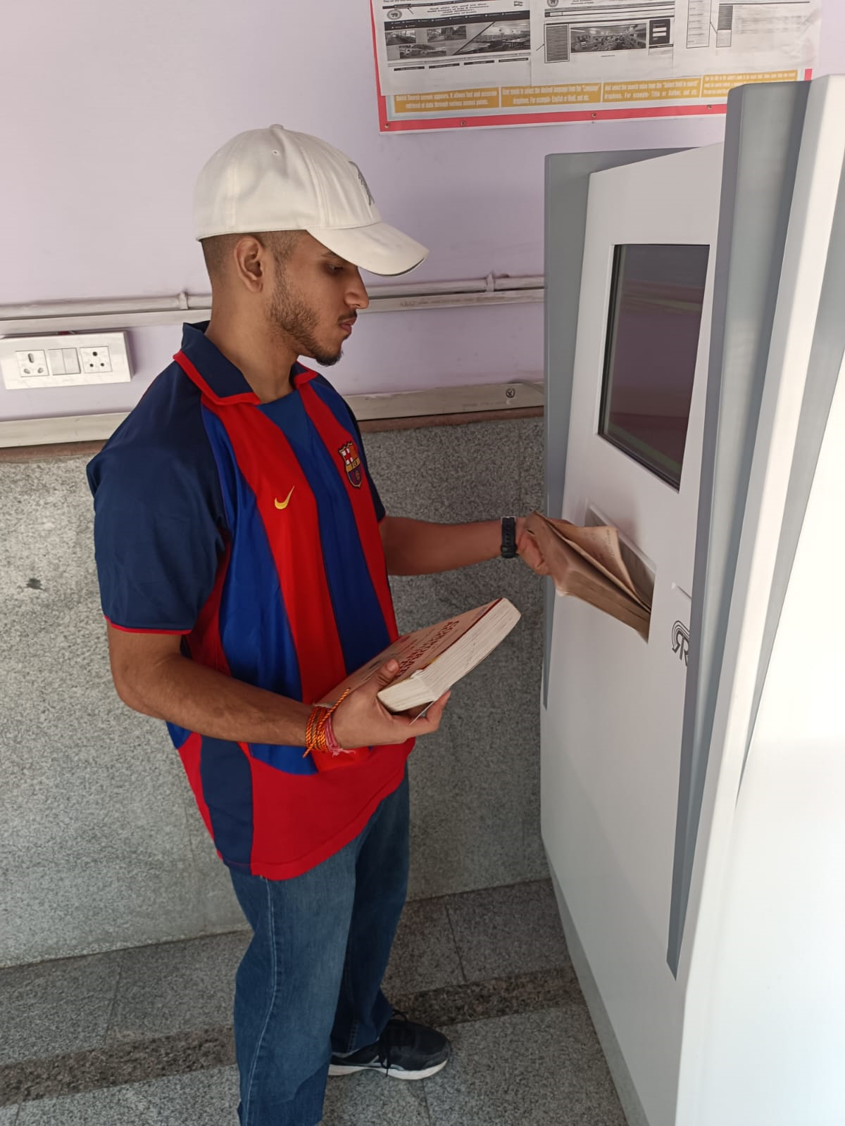
Step 2: Put the Book(s) in Dropbox.
Dropbox will scan and display the book(s) details including barcode, item details, and date due.

Slide 24
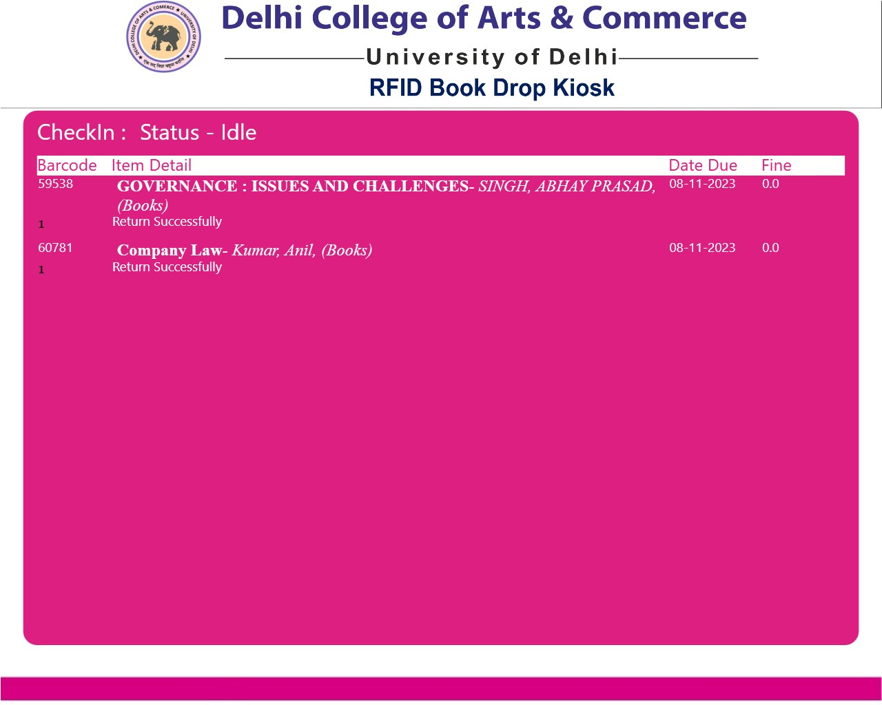
Step 3: Review Book (s) & Fine Details
The kiosk will scan and display the book details, including Barcode, Item Details, Date Due, and any applicable Fine.
If no fine is applicable, the amount against the book(s) entry will show as Zero.

Slide 25
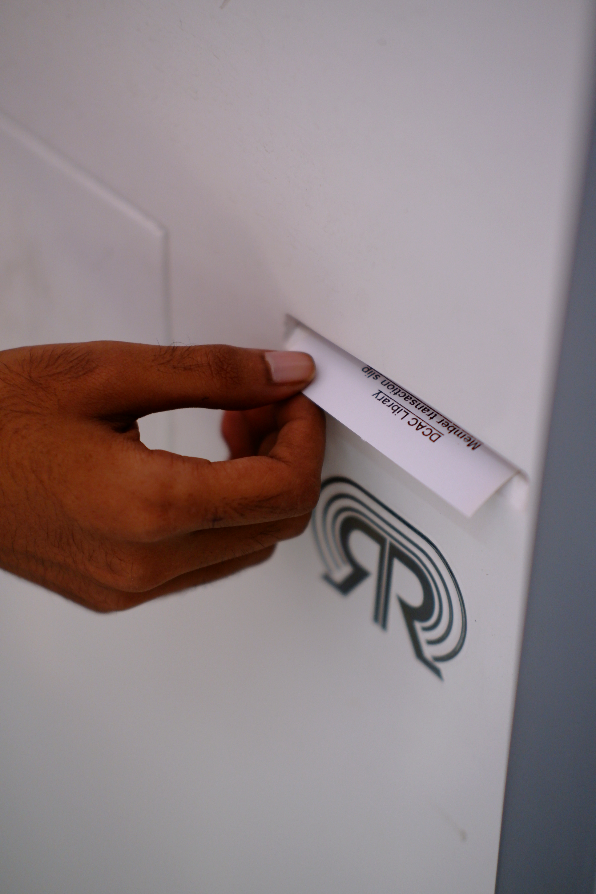
Step 4: Print Transaction Receipt
The kiosk will process the request and generate an automated transaction print receipt for you.
Step 5: Receive Confirmation Email.
A confirmation email detailing the returned book(s) will be sent to your registered email address as per the library's records.

Slide 26
Step 6: Address Overdue Fines (if applicable).
If there's an overdue fine for the book(s), visit the Circulation Counter to pay the fine.
If no fine is applicable, the return process is complete once you receive the automated checked-In transaction receipt.
Step 7: Handover the Receipt to Library Staff.
Before leaving, hand over the printed receipt to the library staff stationed at the exit gate. .
Note: Always ensure to return books on time to avoid late fine.

Slide 27
THANK YOU

